Slide 1
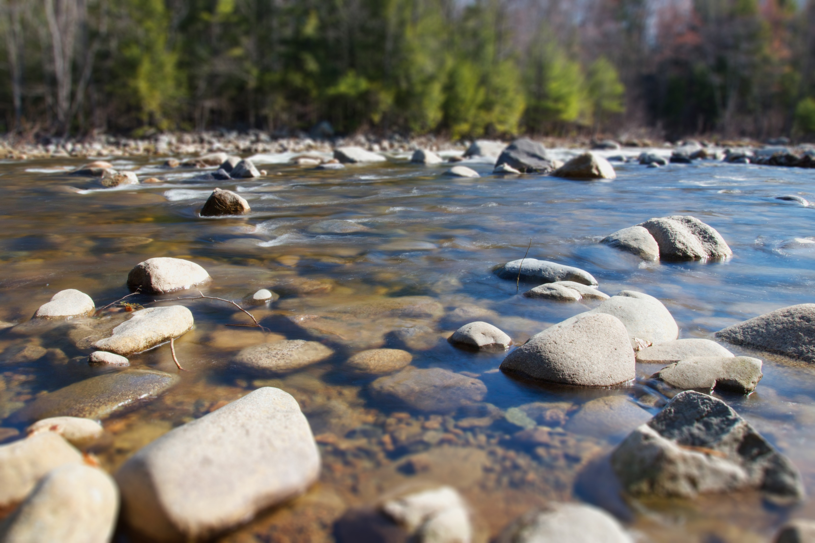
Rocks and Minerals

Slide 2
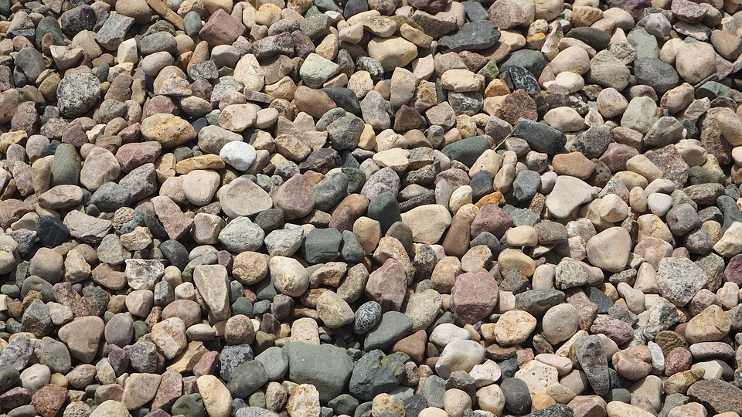
What is a rock?
A rock is a solid made up of one or more minerals. People who study rocks and minerals (Geologists) classify rocks according to the way they are formed.

Slide 3
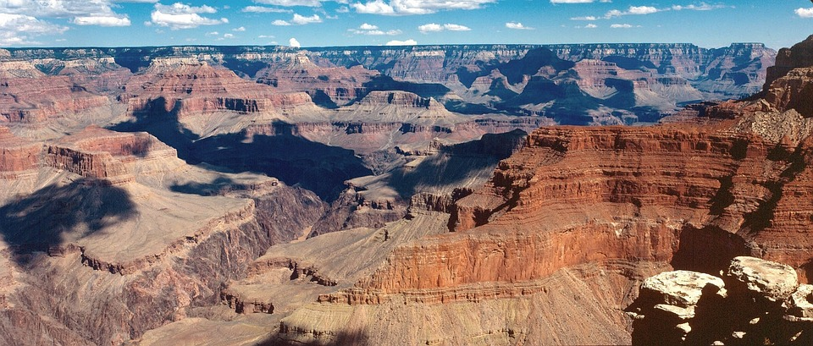
The Grand Canyon in Arizona is made up of layers of rocks. Most of these rocks are called limestones. At the bottom, you will find the oldest rocks and at the top you will see the youngest rocks!

Slide 4
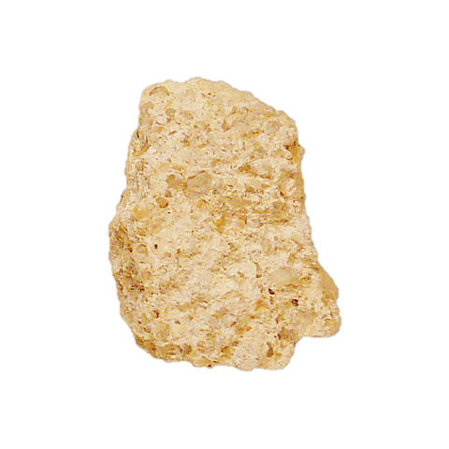
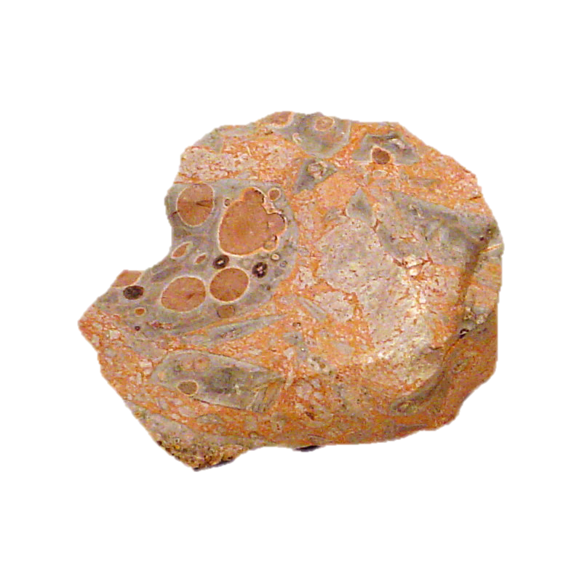
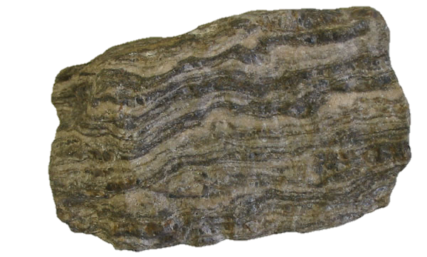
3 Major Types of Rocks:
Metamorphic
Igneous
Sedimentary

Slide 5
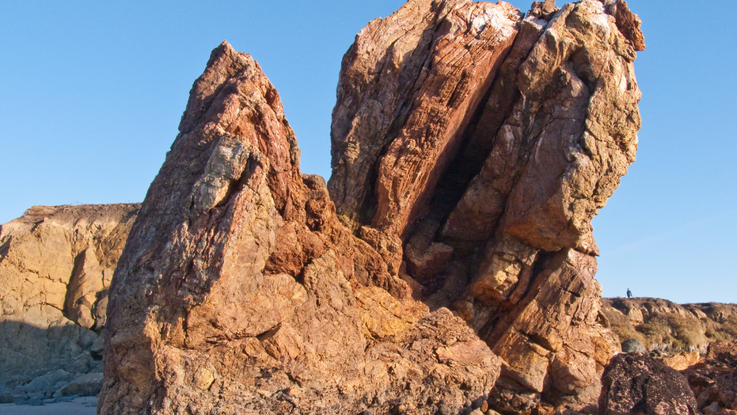
Metamorphic Rocks
Metamorphic rocks are formed by great heat or pressure, or both. They are generally made from other types of rocks such as sedimentary or igneous rocks.

Slide 6
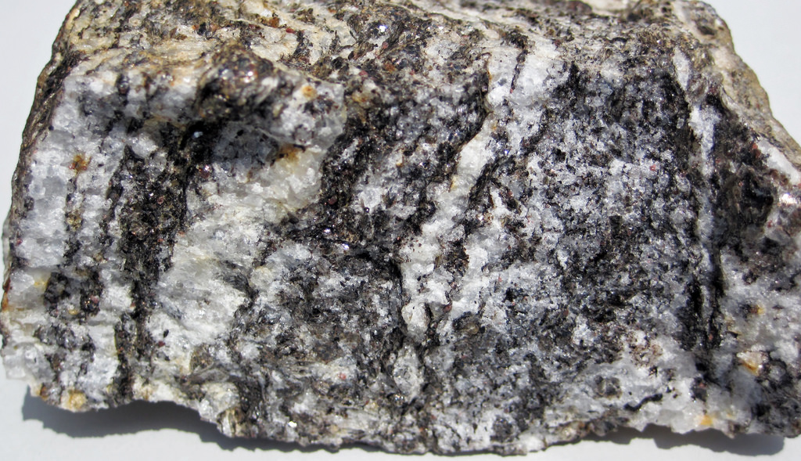
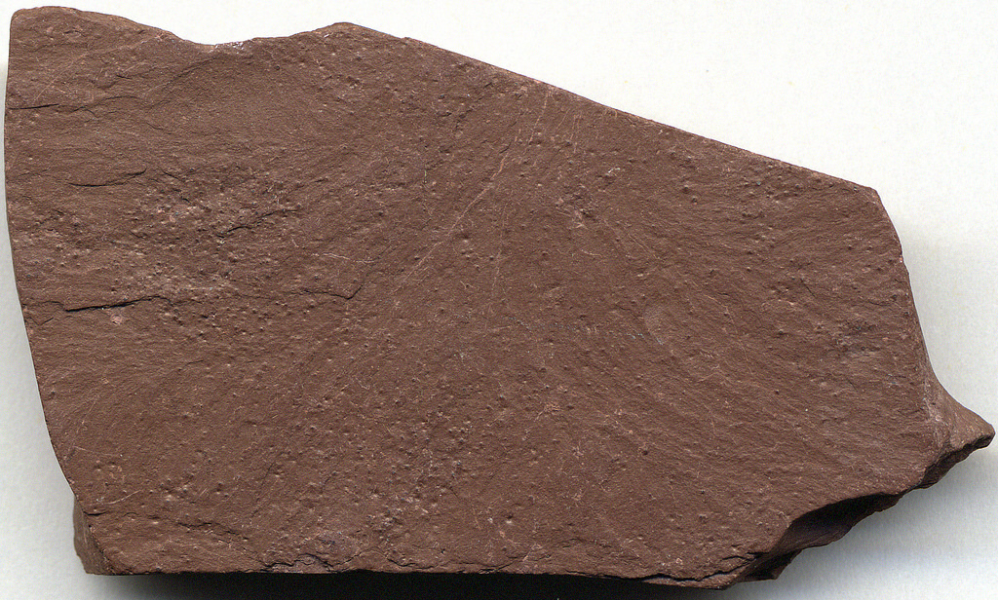
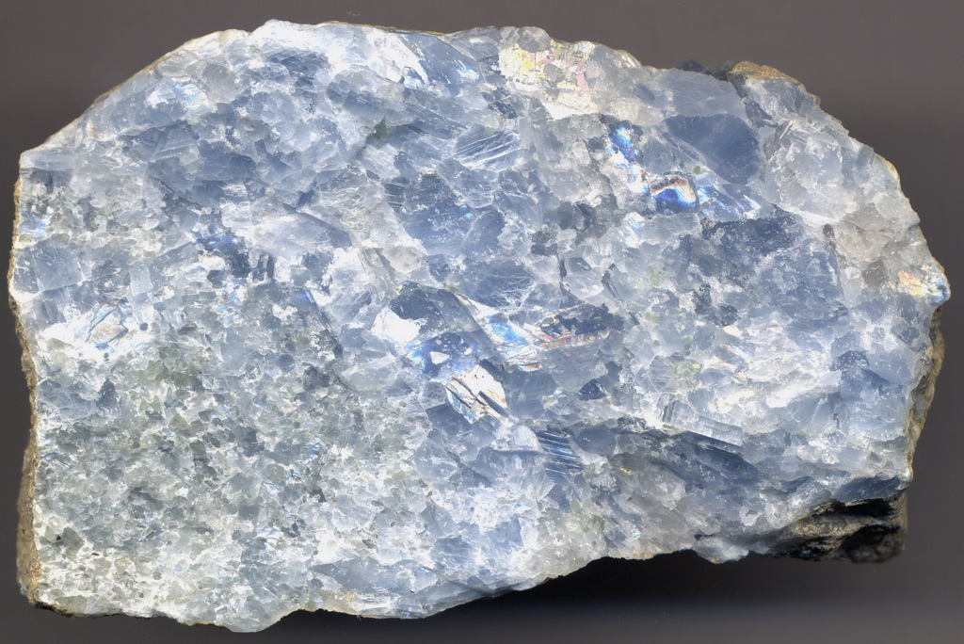
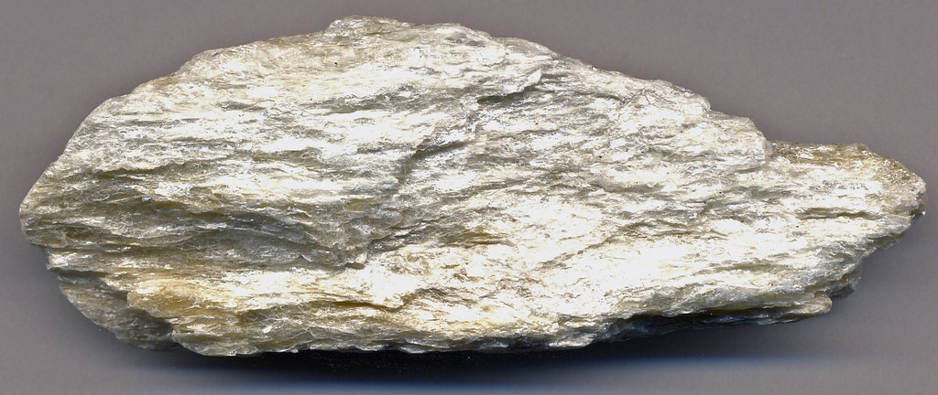
Examples of Metamorphic Rocks:
Gneiss
Slate
Marble
Schist

Slide 7
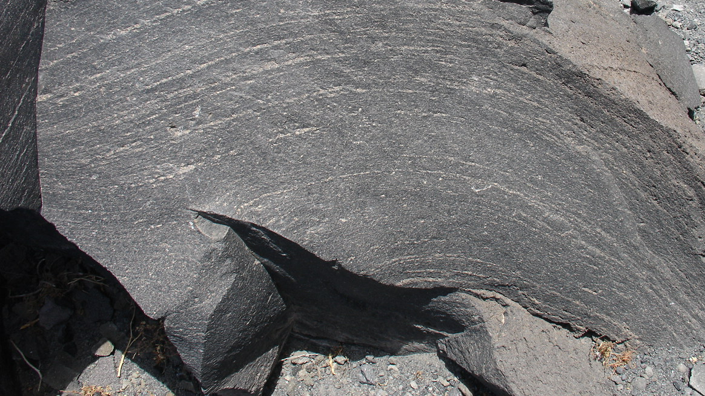
Igneous Rocks
Igneous rocks form when melted rock cools and hardens. Hot molten rock called magma or lava from volcanoes cool down and hardens when it reaches the Earth’s surface or somewhere within the crust.

Slide 8
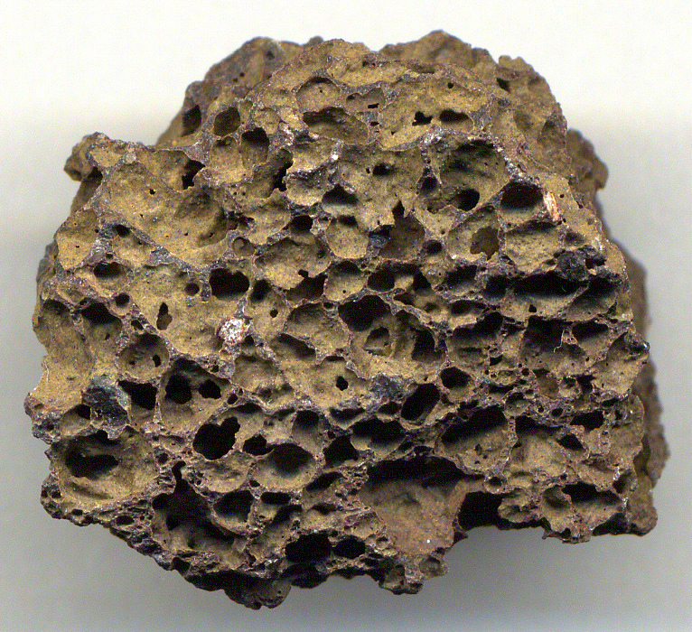
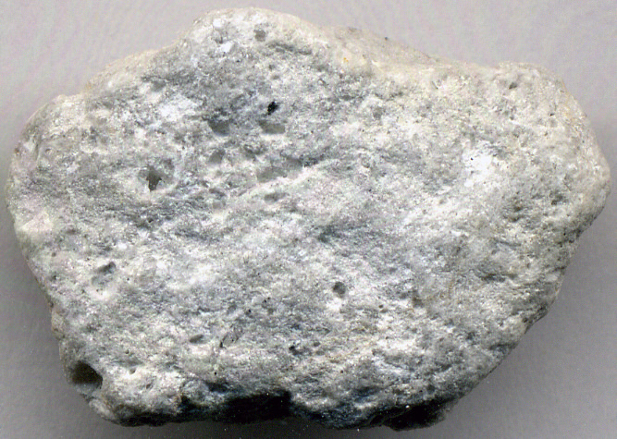
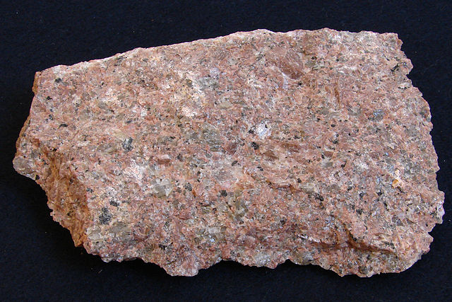
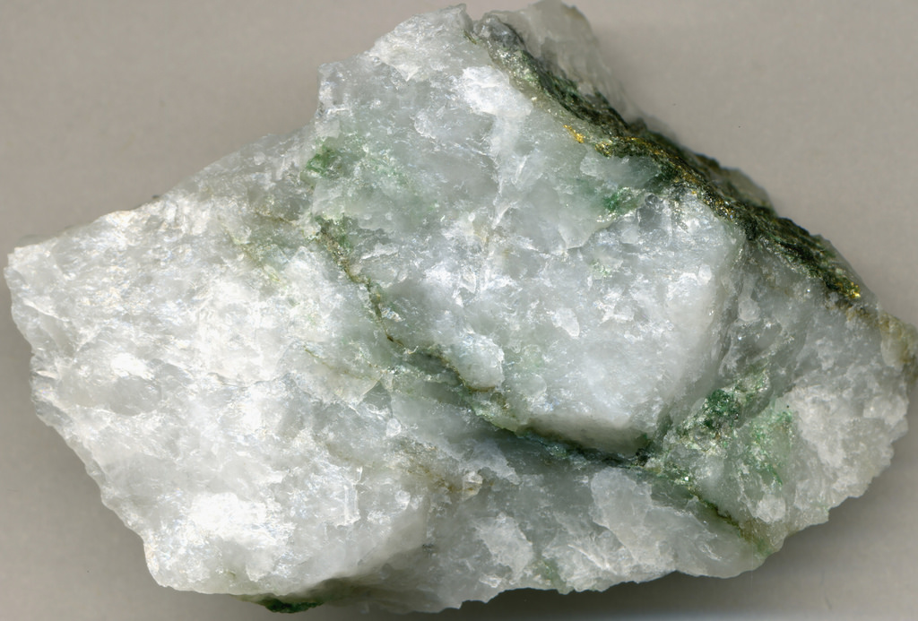
Examples of Igneous Rocks:
Pumice
Basalt
Granite
Quartz

Slide 9
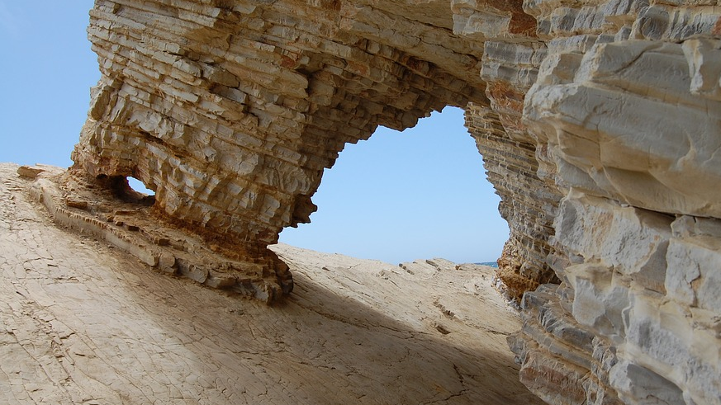
Sedimentary
Rocks
Sedimentary rocks are formed by many years of sediment (many pieces of rock and soil) squeezed together until they harden. (compacted and cemented)

Slide 10
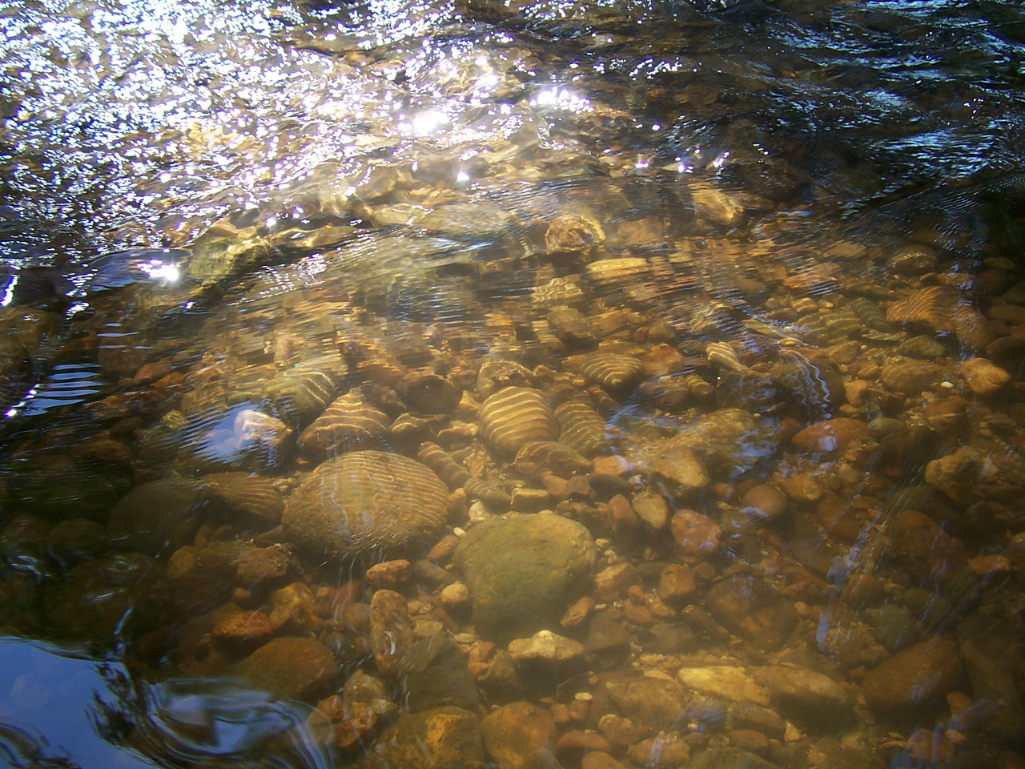
Streams or rivers will carry lots of sediment to a larger body of water and settle at the bottom. Millions of years later, they will form into solid rock.

Slide 11
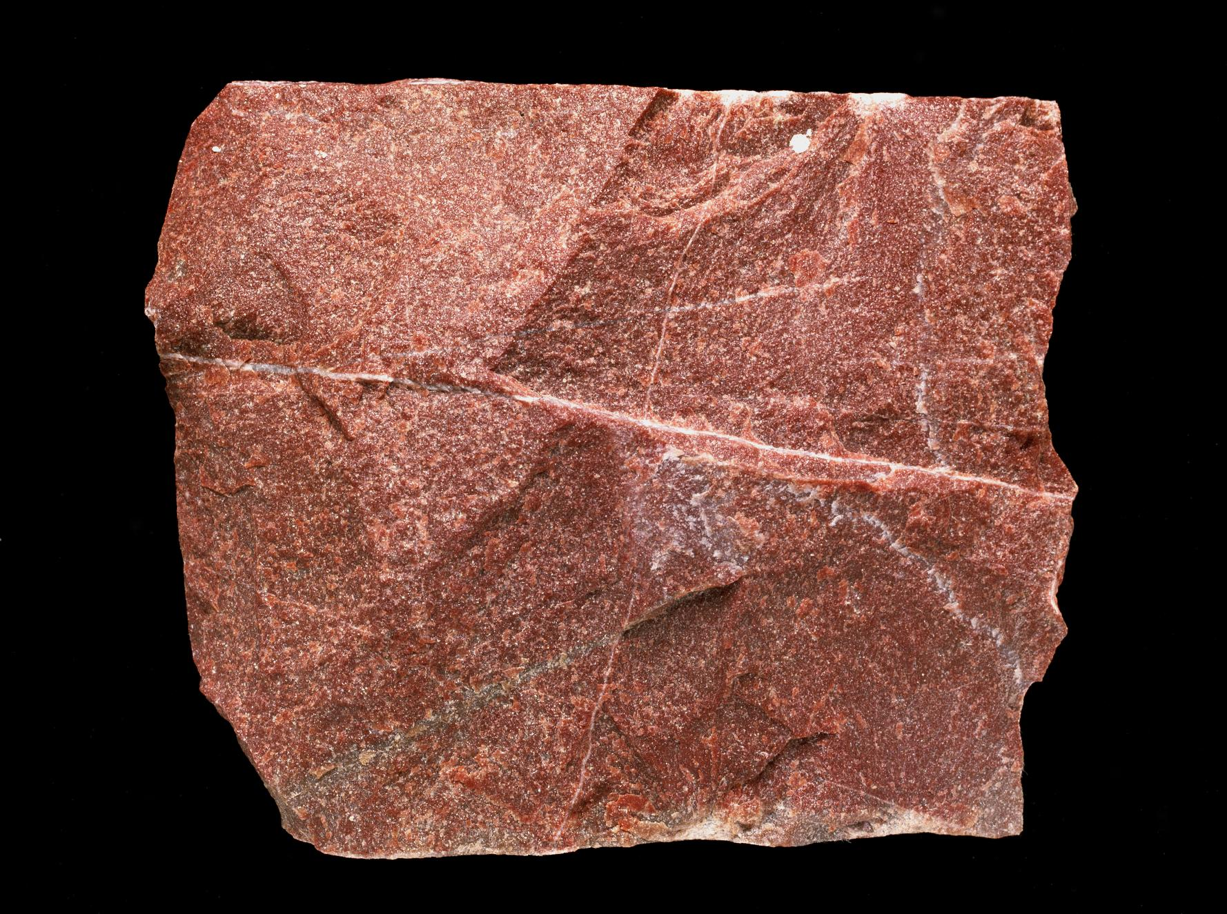
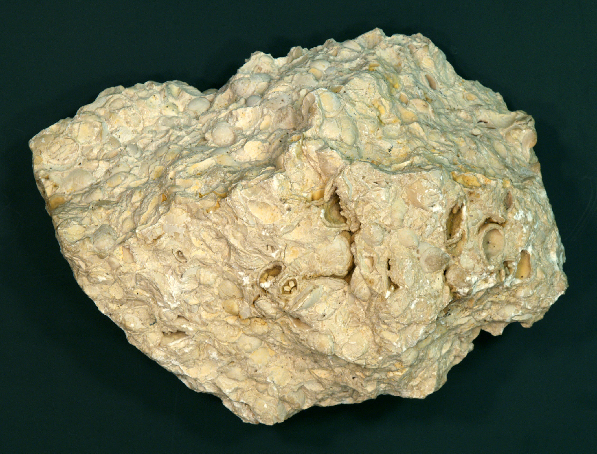
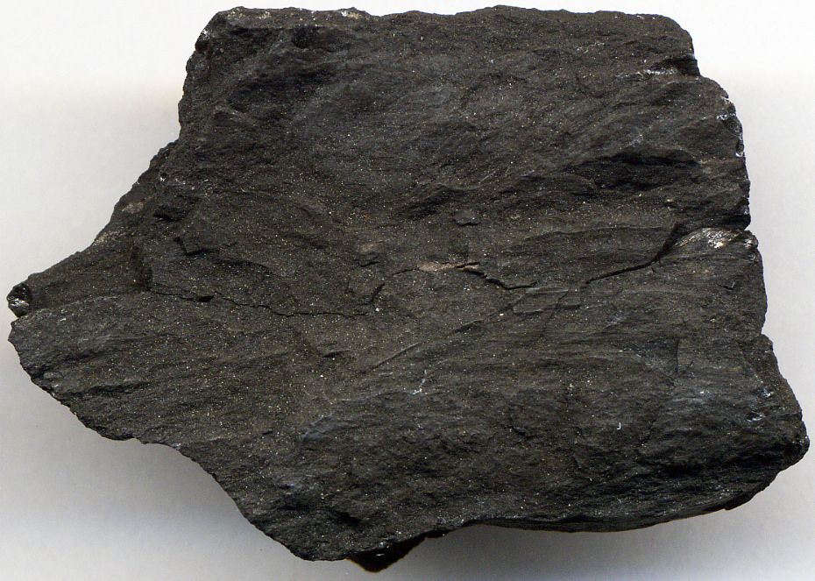
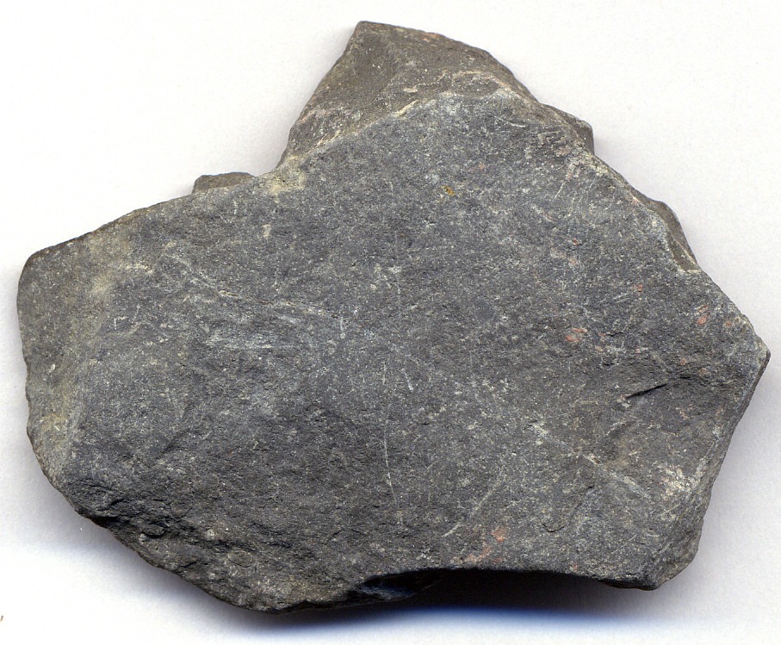
Examples of Sedimentary Rocks:
Sandstone
Limestone
Coal
Shale

Slide 12
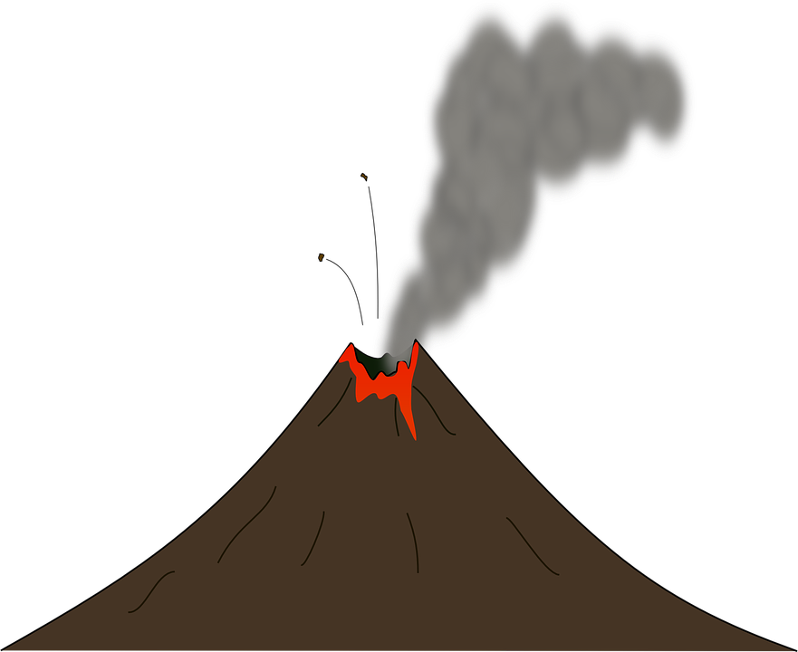
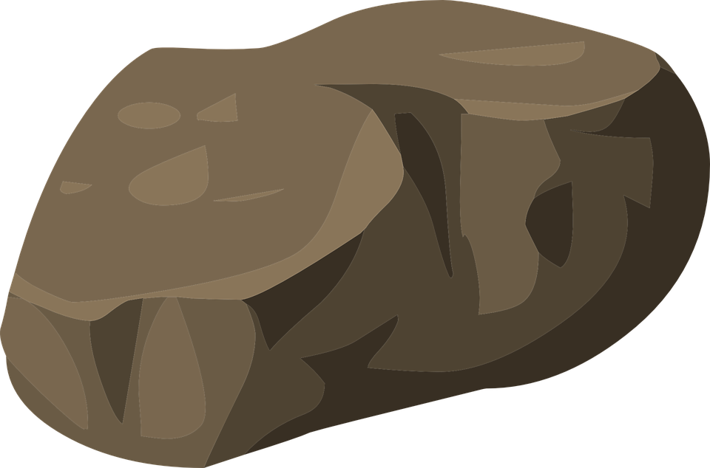
Rocks are always changing and the process of change is called the rock cycle. The changes happen very slowly (millions of years) which makes it difficult to see.
Volcanic Eruption
Magma
Igneous Rock
Metamorphic Rock
Sediments
Sedimentary Rock

Slide 13
C
Y
C
L
E
R
O
C
K
Volcanic Eruption
Cooling
Melting
Magma
Igneous Rock
Melting
Heat and Pressure
Weathering and Erosion
Weathering and Erosion
Metamorphic Rock
Sediments
Heat and Pressure
Weathering and Erosion
Sedimentary Rock

Slide 14
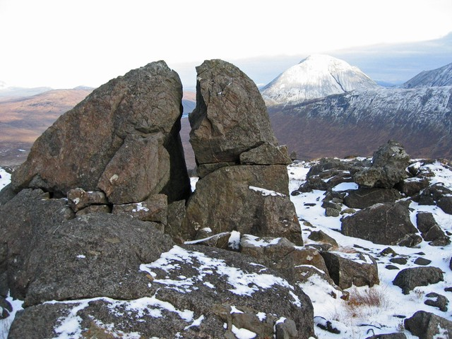
Weathering
Weathering is the process that breaks down rocks into smaller pieces which is caused by wind, rain, ice, chemicals, freezing, or thawing.

Slide 15
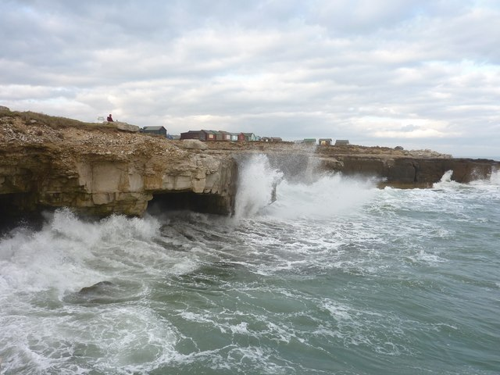
Erosion
After a rock has been broken down into pieces by weathering, it is ready for erosion. Erosion is the movement of rock pieces from place to place which is caused by wind, rain, waves, gravity, or moving ice.

Slide 16
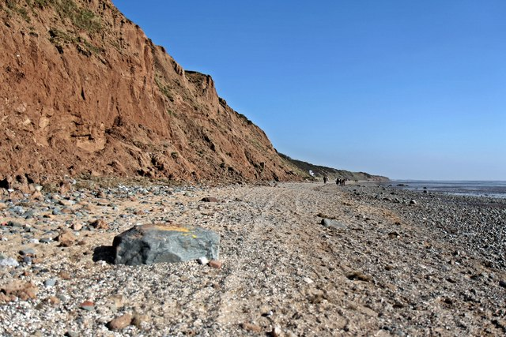
Deposition
Deposition is when the particles carried by water, ice, or wind by the forces of erosion are deposited (dropped) in another location. Basically, when material is added to a landform, we call it deposition.

Slide 17
The Full Picture
Weathering
Erosion
Deposition
1. Rocks are broken down into
small pieces.
2. Small pieces of rock and sand are picked up by the forces of nature.
3. Those sediments are left in a new place.

Slide 18
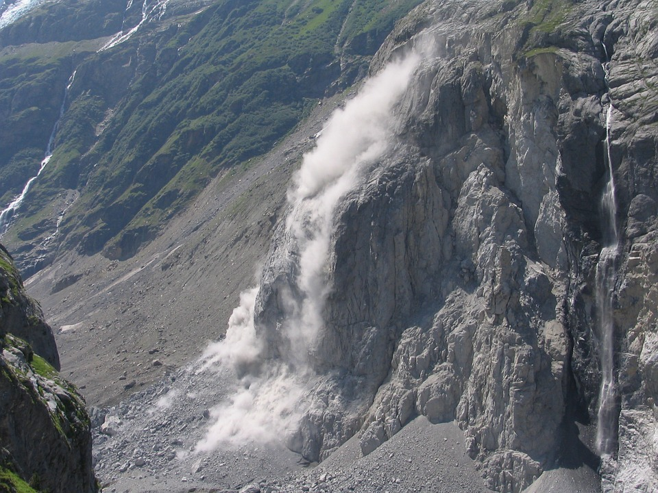
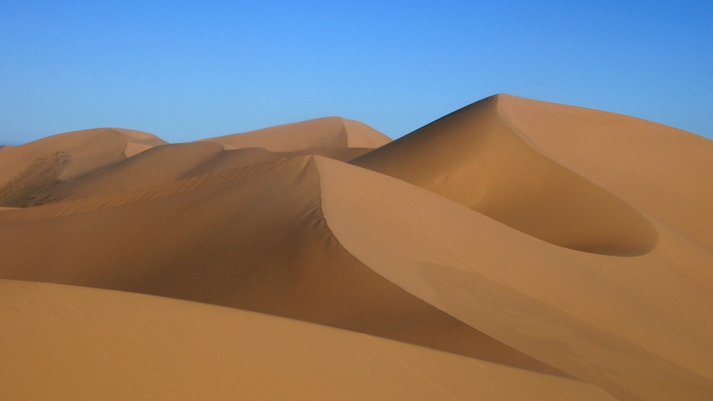
Landforms Produced by Deposition
Rockslides on hills and mountains are created as rocks are deposited.
In the desert, the deposition patterns of the wind creates
sand dunes.
The waves of the ocean create beaches as they deposit sand over time.

Slide 19
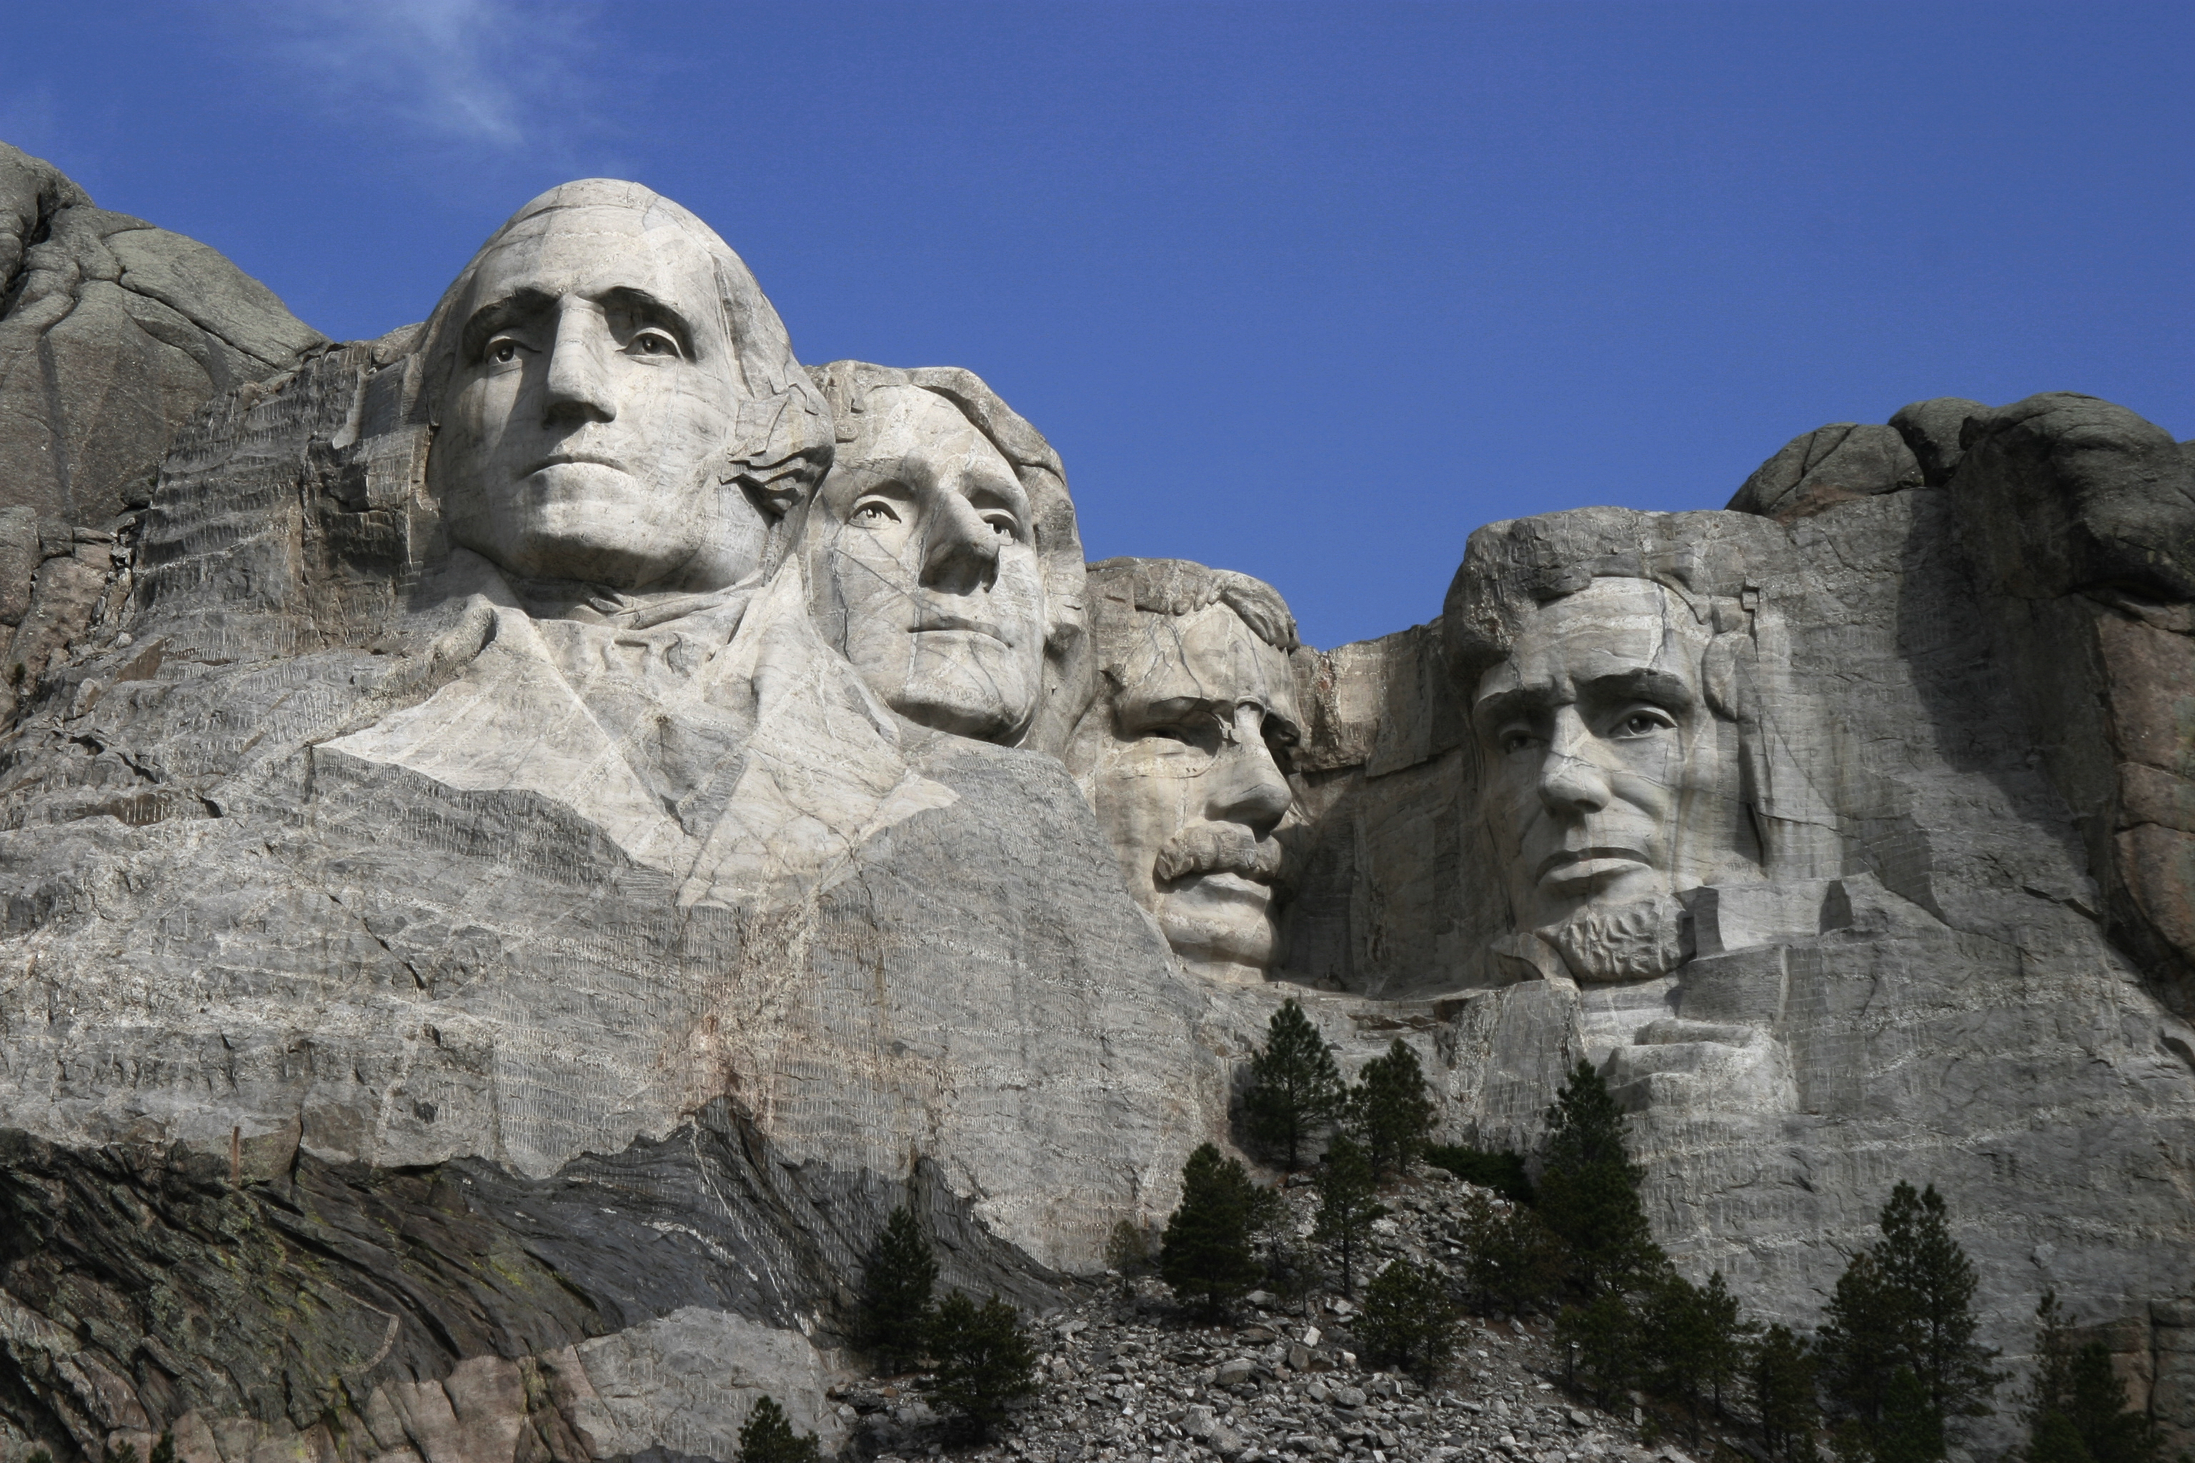
Fun Fact #1
The heads at Mt. Rushmore in South Dakota are carved out of an igneous rock called granite.

Slide 20
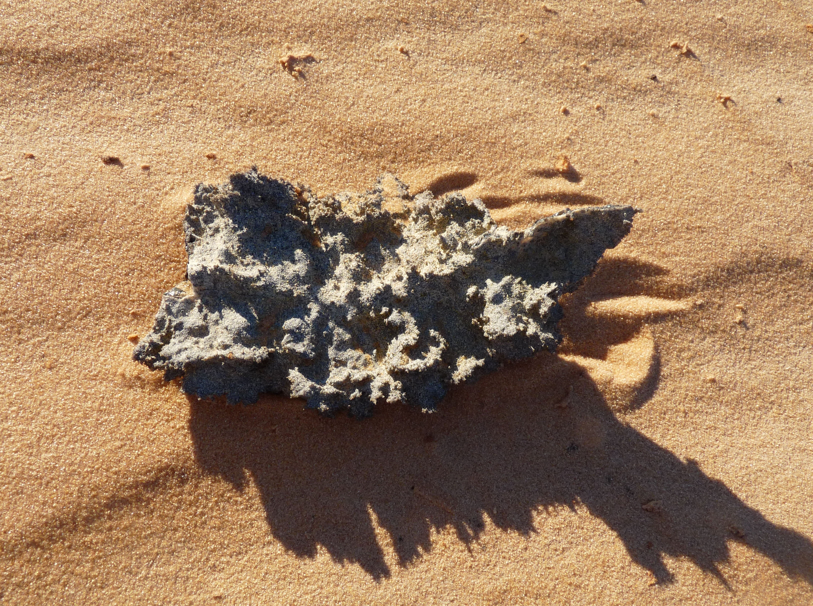
Fun Fact #2
When lightning strikes the sand at the beach, the sand can melt to form a glassy rock called Fulgurite.

Slide 21
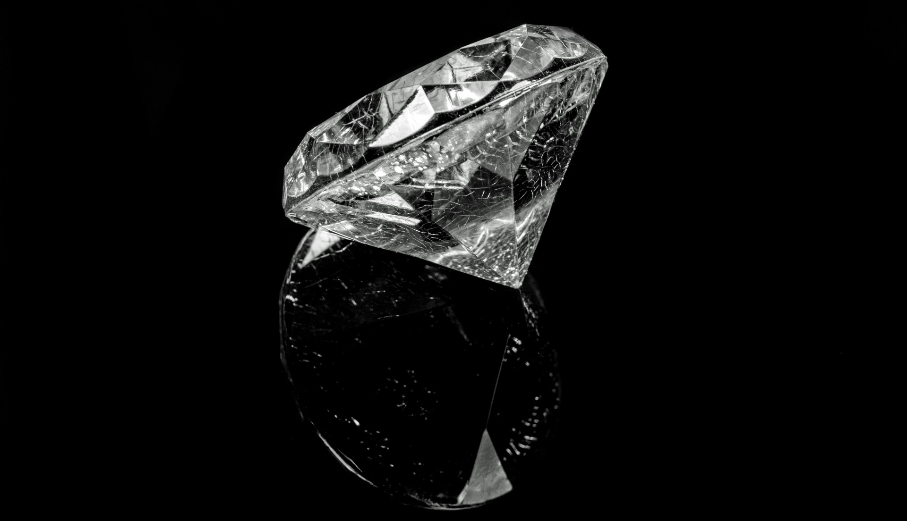
Fun Fact #3
A diamond is the hardest mineral.

Slide 22
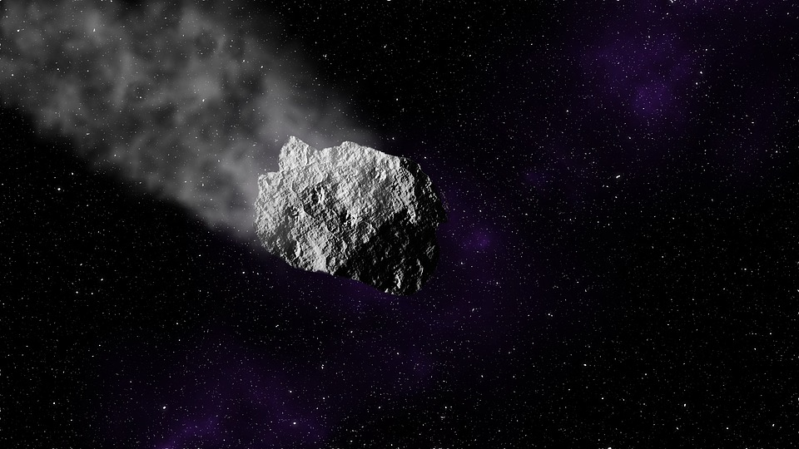
Fun Fact #4
Meteorites are rocks from space and they can help scientists learn new things about our Solar System.

Slide 23
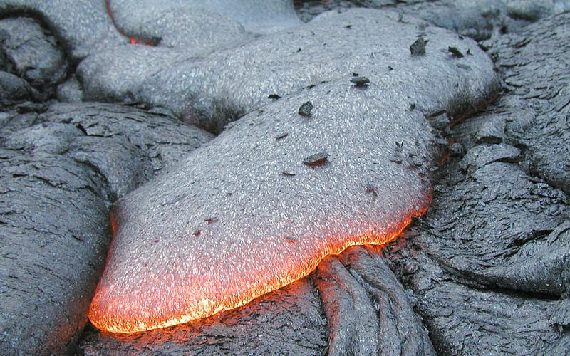
Fun Fact #5
The word igneous comes from the Latin word ignis which means “of fire”.

